Slide 1
Leadership
Tbilisi, May 2018
Anke Weigend, Dr. Sabine Horst
Notes:
Die Informationen auf diesen Sprechernotizen werden eingegeben über
[Ansicht] [Kopf- und Fußzeilen]
Die Formatierung z. B. kursiv bei © dbb akademie wird im Notizenmaster durch Formatierung dieses Platzhalters erreicht

Slide 2
Leadership understanding
Leadership is a process created and developed actively by both, leader and employees
A leader guides or directs others in order to achieve sth respectively have an impact
Employees/Subordinates are those persons who are guided/directed in order to fullfil tasks and duties and to support the vision of the leader
April 2018
2
Leadership

Slide 3
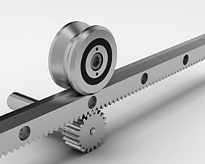
Leadership understanding
Hypothesis:
„First of all, leadership has to do with clarity. Clarity in myself.”
Because only when …
…I am clear about my goals and objectives, I can lead myself and others.
… I have a clear understanding of myself as leader, I have an idea of my effect on others.
I myself see a sense in what I do, I can transport this to others.
Because only when …
…I am clear about my goals and objectives, I can lead myself and others.
… I have a clear understanding of myself as leader, I have an idea of my effect on others.
myself see a sense in what
Notes:
Nennen Sie hierzu einmal Beispiele aus Ihrer Erfahrung. Können Sie diese These bestätigen?
Bsp. aus Coaching: FK muss Erledigung einer Aufgabe bei MA bis zu einem bestimmten Zeitpunkt einfordern, parallel sind andere Aufgaben zu erledigen. MA pendelt zwischen den verschiedenen Aufgaben und bekommt nichts erledigt. FK erkennt im Coaching, dass er selbst unklar ist bezüglich der Prioritäten und an MA missverständliche Botschaften sendet.
Abschließend überleitende Frage auf BOS-Homepage-Auszüge:
Wo bekommen Sie Orientierung für Führung bei BOS?

Slide 4
Managerial and leadership skills
Management Leadership
Put structures into place Social competences
Build up processes Focus on relational tasks
Direct processes Promote job satisfaction
Factual tasks Promote motivation
Specialised competences Reflect Individual and
social needs
Optimise productivity Bring the employees‘
goals into harmony with
the organisation‘s goals
April 2018
4
Leadership

Slide 5

Leadership competencies - Iceberg model
Factual level (management):
strategy, planning, controlling, organisational charts, job descriptions, processes …
rational, observable aspects 15 percent
Interpersonal level (leadership):
distribution of power, group dynamics, interactions, values, roles, needs, expectations, fears, motivations, corporate culture …
affective, hidden aspects
85 percent

Slide 6
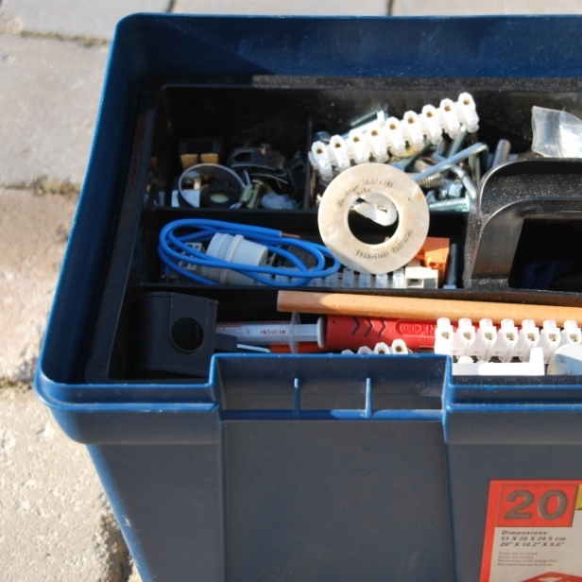
Leadership tasks
Task of leadership is to create an own, individual "leadership toolbox".
These include:
the ability to activate their own skills
know the appropriate tools and apply these

Slide 7
Behavioural dimensions of leaders
Persuasion skills
Assertiveness
Cooperative ability
Empathy
April 2018
7
Leadership

Slide 8
Leadership behaviours
Leadership is . . .
recognising the performance and value of others and their contributions.
cooperation and control.
strategically using the respective
skills of people.
embracing change.
life-long learning.
April 2018
8
Leadership

Slide 9
Traditional leadership styles
Top-down leadership:
Authoritative/autocratic leadership style
Participation by the employees:
Cooperative (participative), democratic
leadership style
Employees are autonomous:
Laissez-faire leadership style
April 2018
9
Leadership

Slide 10
Traditional leadership styles
Decision-making in co-operation with team/group
Decision-making by supervisor
Supervisor decides,
if necessary by force
Supervisor decides and enforces with manipulation
Supervisor decides and convinces others
Supervisor informs, seeks opinion of those affected by decision
Group makes suggestions,
supervisor selects
Group decides autonomously within the agreed framework
Group decides autonomously,
superior acts as an integrator, co-ordinator
„authoritarian“
„patriarchal “
„informing“
„advisory “
„cooperative“
„participatory“
„democratically“
Authoritarian leadership style
democratic
leadership style
source: Tannenbaum, R./Schmidt, W. Führungsstile. 1958
1958 developed by Tannenbaum and Schmidt, based on Kurt Lewin´s two poles "authoritarian" vs."democratic"

Slide 11
Modern leadership styles
Leadership styles in the systemic intelligent management
directive (task-oriented)
organising (focus on organisation and processes)
modelling (cultural development)
coaching (person-oriented)
dialogic (shaping relationships)
April 2018
11
Leadership

Slide 12
Modern leadership styles
Goal: situative leadership
Because: different specific needs for action and different potential of employees require different leadership styles
Therefore: assessment cannot be „right“ or „wrong“, it can only be „appropriate“ or „inappropriate“
April 2018
12
Leadership

Slide 13
The concept of situative leadership
Employees and task orientation:
Guiding
Training
Supporting
Delegating
Depends on the level of maturity. (The criteria are related to the tasks in question.)
April 2018
13
Leadership

Slide 14
Situative leadership according to Hersey and Blanchard
Behaviour based on tasks:
The degree to which the supervisor intervenes in the implementation of tasks.
Behaviour based on employees:
The behaviour in which the supervisor seeks discussion with the employee and offers social and emotional support.
April 2018
14
Leadership

Slide 15
Situative leadership
In a nutshell:
Different performance skills and motivation of employees require
different leadership skills.
The performance skills and the employee’s willingness to perform and learn should be promoted and properly acknowledged.
April 2018
15
Leadership

Slide 16
Taking employees‘ values, desires and interests into consideration
Meaning
Self-realisation
Fairness and trust
Appreciation
Transparency and trust
Possibility to actively participate (autonomy)
Sense of community
Performance
Need to feel safe and secure
Predictability
April 2018
16
Leadership

Slide 17
Motivational factors
Salary which reflects requirements and performance
Collegial relationships at the workplace
Guarantee of information and communication
Sufficient office space and equipment
Job security
Social benefits
Adequate social and personal status
April 2018
17
Leadership

Slide 18
Motivational factors
Services rendered and success stories
Recognition, praise and appreciation
Taking on responsibility
Challenging tasks
Possibilities for career advancement
Training opportunities and learning outcomes
April 2018
18
Leadership

Slide 19
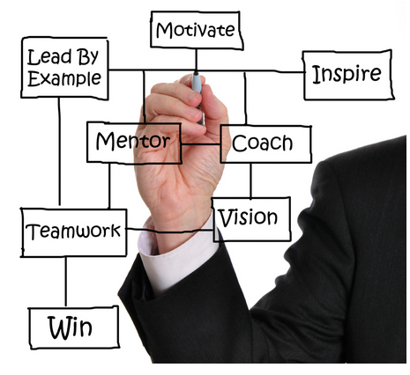
Leadership roles
Examples:
Decision Maker
Strategist
Presenter
Mediator
Change Manager
Bearer of "bad" and "good" news
Person in charge
Ombudsman
…
April 2018
19
Leadership

Slide 20
Leadership: roles, responsibilities, expectations
You have to motivate people, assert yourself!
Be fair, open-minded, co-operative. Ask for feedback from your employees.
Superior
Personnel Department
Bring your people on their toes! Or is "customer orientation" a foreign word to you?
Client
More tasks, less people …!?
Make sure that we have sufficient resources! You are our representative for the top management!
Employee
Notes:
- Auf Flipchart ergänzend die Systeme herausarbeiten: Ich-System, bilateral mit MA und Vorgesetztem, Team bzw. Werk, Unternehmen, Außenwelt
=> viele verschiedene Kontexte, damit unterschiedliche Aufgaben und –rollen und unterschiedliche Führungsinstrumente
=> zentral im Kern: Selbstführung bzw. -management

Slide 21

Employees‘ expectations: leaders duties and responsibilities
t
An evaluation of coaching sessions show that in terms of employees and teams a leader should …
… be loyal to the company/institution,
… know the corporate objectives and can derive/define objectives for the own area of ​​responsibility,
… be able to develop adequate processes,
… act as model,
… have the ability of self-control and self-motivation
… be open for criticism, admit own faults and support a culture that can learn from mistakes,
Notes:
Werkzeuge; roter Faden

Slide 22
… have confidence in staff and know their abilities and potential,
… delegate tasks and responsibilities,
… address problems/conflicts and resolve them in a team,
… give appreciation and constructive feedback in an authentic manner,
... focus more on strengths rather than weaknesses,
… have regular contact with employees,
… create a motivating atmosphere,
… encourage and challenge employees,
… know about team structures, team roles and team development processes,
… know how to create and benefit from synergies within a team and how to manage conflicts.

Slide 23
Dilemmas in leadership roles
Equal treatment of all |  | Individuality and reflection of the individual
Distance from the employees |  | Closeness and warmth
Control |  | Trust
Stability and security |  | Innovation and change
Competition |  | Cooperation and harmony
Self-orientation |  | Team orientation
Leadership

Slide 24
Characteristics of leadership according to gender
Women | Men
Social competence | Assertiveness
Holistic thinking | Well-structured
Problem-solving competence | Decision-making skills
Organisational talent | Stress resistant
Employee orientation | Task and competition orientation
Less hierarchy and status orientation | Hierarchy and status orientation
More tendancy towards participative, relationship-oriented leadership style | More tendancy towards autocratic, factual-oriented leadership style
Leadership

Slide 25
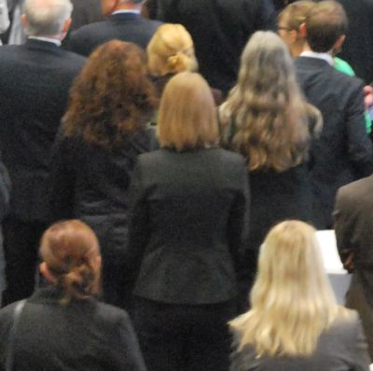
Self-management – Objectives
O B J E C T I V E S
FOCUS
disturbances
problems
challenges
interferences
problems
problems
distractions
Notes:
- Meine Beobachtungen im Coaching häufig: Führungskräfte können oft beschreiben, was nicht sein sollte, aber nicht, was stattdessen sein sollte

Slide 26
„The one who knows the goal, can decide.
The one who decides, finds stability.
The one who finds stability, feels safe.
The one who feels safe, can reflect.
The one who reflects, can improve things.”
Konfuzius

Slide 27
Self-management
Objectives…
are relevant for a team to understand what is the direction we are heading
help to develop a team vision
can be transformed into tasks
increase reliablity and commitment, especially if agreed jointly
are motivating if emotionally stimulating and acceptable

Slide 28
Objectives…
stimulate discussions on conditions and counter-arguments and, therefore, provide a basis for a clarification.
support to join different forces, to solve conflicts
support the definition of responsibilities including limits
are essential for a situational leadership style to be effective
April 2018
28
Leadership

